Slide 1
KUMARAKABILAN P
Final Project
: MindWell - A Health Chatbot for Well-being and Support
3/21/2024 Annual Review

Slide 2
PROJECT TITLE
Project Title: MindWell - A Health Chatbot for Well-being and Support
Problem Statement:
Many individuals face challenges in accessing timely and reliable mental health support. MindWell aims to bridge this gap by providing a user-friendly chatbot platform that offers guidance, resources, and assistance for mental well-being.
3/21/2024 Annual Review

Slide 3


AGENDA
Introduction and Goals
Overview of project goals and objectives
Research and Planning
Research on mental health issues and existing chatbots
Define target audience and their needs
Design and Development
Design conversational flow and user interactions
Develop chatbot using NLP and external APIs
Data Collection and Preparation
Gather resources and create a knowledge base
User Interface
Design user-friendly interface and conduct usability testing
Testing and Feedback
Test chatbot functionality and gather user feedback
Iterate and improve based on feedback
Deployment
Deploy chatbot on suitable platform
Promote to target audience and monitor usage
Documentation and Future Plans
Document development process and decisions
3/21/2024 Annual Review

Slide 4

PROBLEM STATEMENT
Many individuals face barriers in accessing timely and personalized mental health support due to limited availability of professionals, stigma, and lack of tailored resources.
Many individuals struggle to access timely and reliable mental health support.
Limited availability of mental health professionals leads to long waiting times for appointments.
Stigma surrounding mental health often prevents people from seeking help.
Existing resources may not be easily accessible or tailored to individual needs.
Lack of awareness about mental health issues and coping strategies contributes to the problem.
3/21/2024 Annual Review

Slide 5

PROJECT OVERVIEW
Objective: Develop a user-friendly chatbot, MindWell, to provide accessible and personalized mental health support.
Features: Conversational interface, natural language processing (NLP), resource database, privacy compliance.
Target Audience: Individuals seeking mental health guidance and support.
Impact: Reduce barriers to mental health care, increase awareness, and promote well-being.
Approach: Research-based design, iterative development, user testing, and continuous improvement.
3/21/2024 Annual Review

Slide 6

WHO ARE THE END USERS?
Who are our end users?
Individuals seeking mental health support and guidance.
People experiencing stress, anxiety, depression, or other mental health concerns.
Caregivers or friends looking for resources to support loved ones.
What do they need?
Accessible and confidential mental health support.
Tailored resources and coping strategies.
Guidance on managing emotions and seeking professional help when needed.
How does MindWell help?
Provides a safe and anonymous platform for discussing mental health concerns.
Offers personalized resources, coping techniques, and self-help tools.
Encourages awareness, destigmatization, and proactive well-being practices.
Why choose MindWell?
User-friendly interface with easy navigation.
Confidentiality and privacy protection.
Continual updates based on user feedback and latest research.
3/21/2024 Annual Review

Slide 7
YOUR SOLUTION AND ITS VALUE PROPOSITION
MindWell Chatbot: AI platform for personalized mental health support.
Value Proposition:
Accessible 24/7 support.
Personalized guidance and resources.
Confidential and secure environment.
Key Features:
Conversational interface.
Resource database with coping strategies.
Integration with professional services.
Why Choose MindWell?
Comprehensive support.
User privacy and security.
Continuous improvement based on feedback.
3/21/2024 Annual Review

Slide 8
THE WOW IN YOUR SOLUTION
User-Centric Design: MindWell's intuitive interface and empathetic responses create a comfortable and engaging user experience.
Personalization: Tailored recommendations and resources based on each user's unique needs and preferences.
24/7 Accessibility: Instant access to mental health support anytime, anywhere, promoting proactive well-being.
Comprehensive Support: From coping strategies to professional services integration, MindWell offers a holistic approach to mental well-being.
Continuous Improvement: Regular updates and enhancements ensure that MindWell remains at the forefront of effective mental health support.
Impactful Results: Positive feedback and testimonials showcase the real difference MindWell makes in users' lives.
Future Vision: Innovations and expansions planned to further enhance MindWell's capabilities and reach.
3/21/2024 Annual Review
‹#›

Slide 9
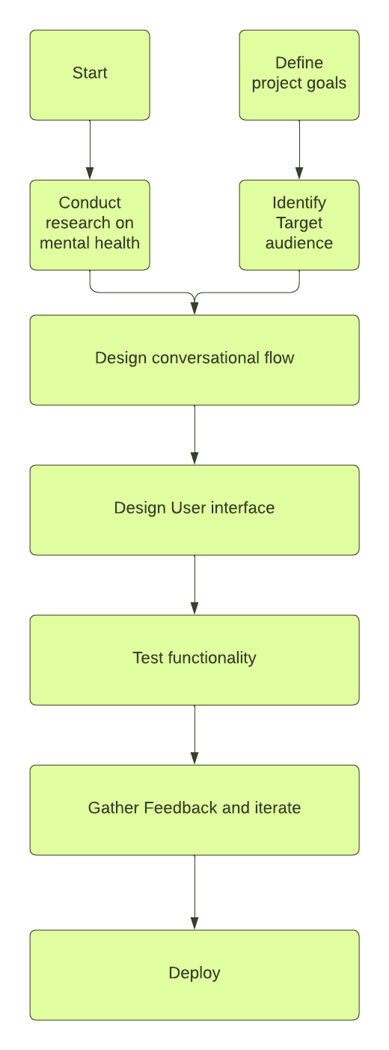
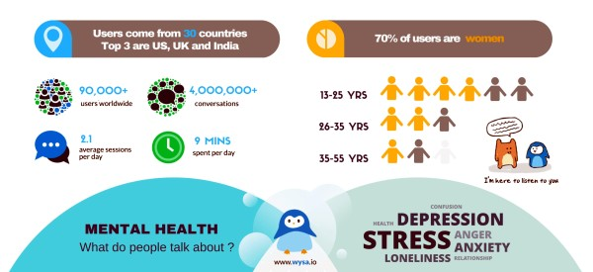
MODELLING
Teams cam add wireframes
Overview of modelling approach
NLP techniques
Machine learning algorithms
Key Components
Data integration
Algorithmic framework
Model training
API integration
Scalability considerations
Evaluation metrics
Future enhancements
3/21/2024 Annual Review
‹#›

Slide 10
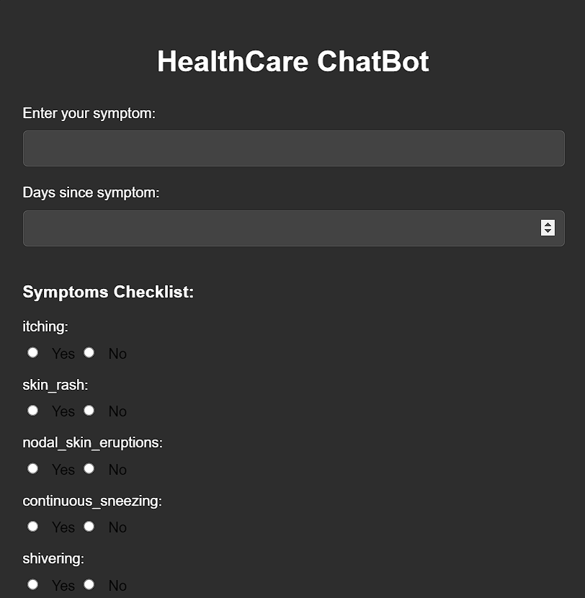
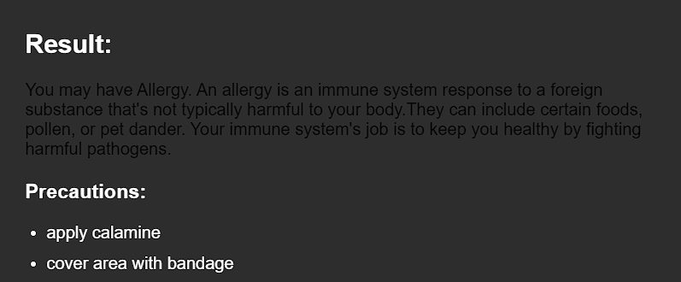
RESULTS
Demo Link://github.com/kabixit/TNSDC-Generative-AI
3/21/2024 Annual Review
‹#›

